Slide 1


Marcia Pedro
March 24, 2022

Slide 2

Outline
Executive Summary
Introduction
Methodology
Results
Conclusion
Appendix

Slide 3
Executive Summary
Summary of methodologies
Data Collection using API
Data Collection with Web Scraping
Data Wrangling
Exploratory Data Analysis with SQL
Exploratory Data Analysis with Data Visualization
Interactive Visual Analytics and Dashboards
Machine Learning Predictive Analysis
Summary of all results
Exploratory Data Analysis Result
Interactive Visual Analytics Results
Predictive Analytics Result

Slide 4
Introduction
SpaceX is very proud of the fact that Falcon 9 rocket launches cost 62 million dollars while other providers cost upward of 165 million dollars each. This is made possible because SpaceX reuses the first stage. Therefore, if we can determine if the first stage will land, we can determine the cost of a launch. This information can be used if an alternate company wants to bid against SpaceX for a rocket launch. The object it of this project is to predict if the Falcon 9 first stage will land successfully using Machine Learning Predictive Analysis to get the results.
Some of the answers that we want to find are:
What determines if the rocket will land successfully?
What interactions determine the success rate of a successful landing?
What operating conditions needs to be in place to ensure a successful landing program?

Slide 5

Section 1

Slide 6
Methodology
Executive Summary
Data collection methodology:
The data was collected using SpaceX API and web scraping from Wikipedia.
Perform data wrangling:
The data was processed by applying one-hot encoding to categorical features
Perform exploratory data analysis (EDA) using visualization and SQL
Perform interactive visual analytics using Folium and Plotly Dash
Perform predictive analysis using classification models
How to build, tune, evaluate classification models

Slide 7
Data Collection
The methods used to collect the data are as follow:
First, get request to the SpaceX API was used to collect the data.
Then, we decoded the response content as a Json using .json() and turned it into a Panda dataframe using .json_normalize().
Next, we dealt with these missing values by checking if there was any and filling it in if necessary.
When it comes to Web scraping, this is what was done:
First, we carried out web scraping to collect Falcon 9 launch records from a Wikipedia were BeautifulSoup object from the HTML response was used.
Then, we collect all relevant column names from the HTML table header so that we can create an empty dictionary with keys from the extracted column names. Later, this dictionary was converted into a Pandas dataframe

Slide 8
Data Collection – SpaceX API
To collect data, get request to the SpaceX API was used, then we cleaned the data and performed data wrangling.
This is the link to the notebook: https://github.com/marciamk8/testrepo/blob/main/SpaceX%20Data%20Collection%20and%20Data%20Wrangling%20Part%201.ipynb

Slide 9
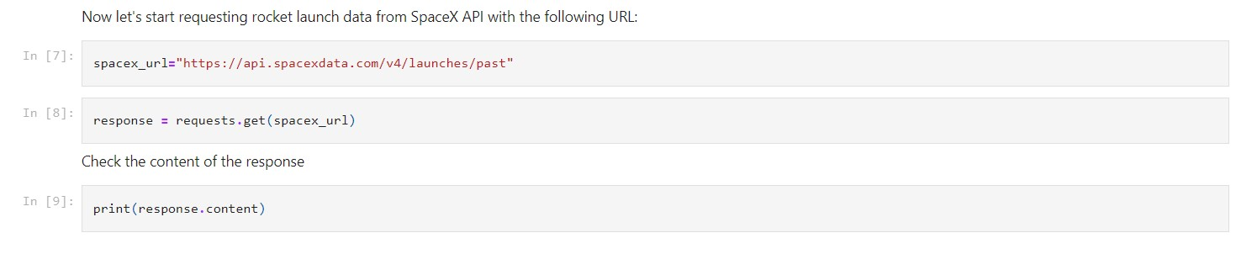
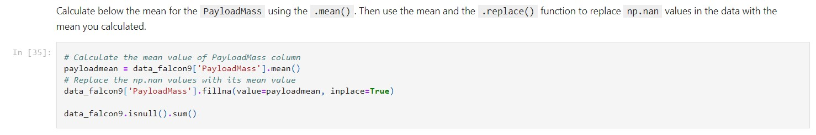
Data Collection – SpaceX API

Slide 10
Data Collection - Scraping
We carried out web scraping to collect Falcon using BeautifulSoup. Then, we collect all relevant column names from the HTML table header so that we can create an empty dictionary and converted into a Panda dataframe.
This is the link to the notebook: https://github.com/marciamk8/testrepo/blob/main/SpaceX%20Web%20Scraping%20Part%202.ipynb

Slide 11
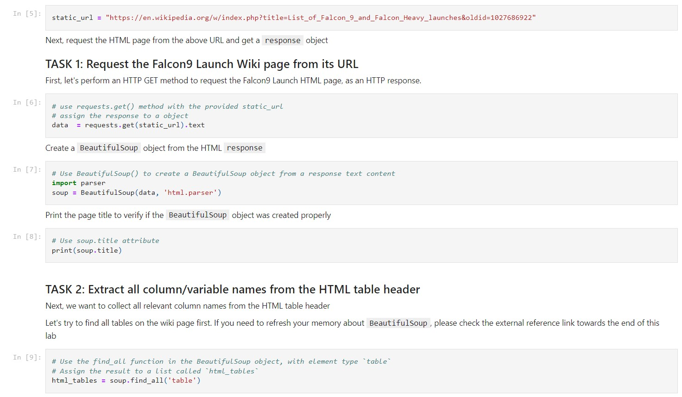
Data Collection - Scraping

Slide 12
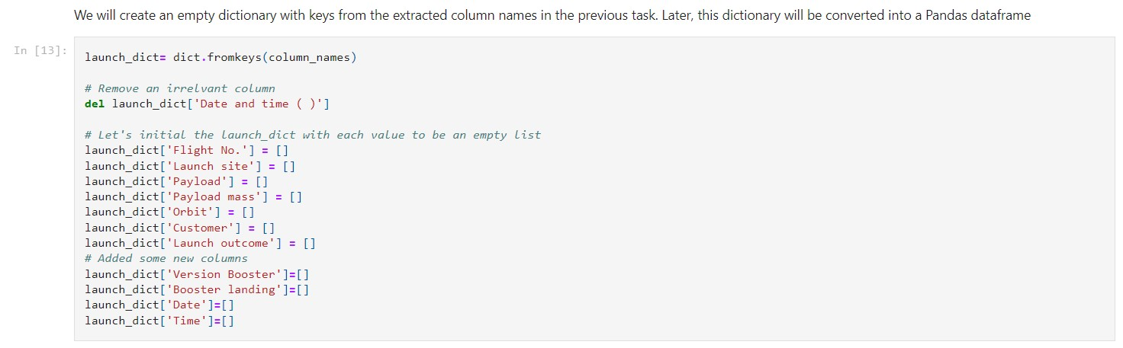
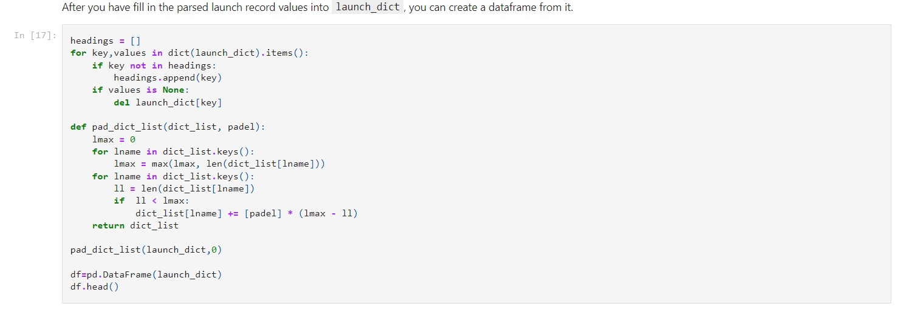
Data Collection - Scraping

Slide 13
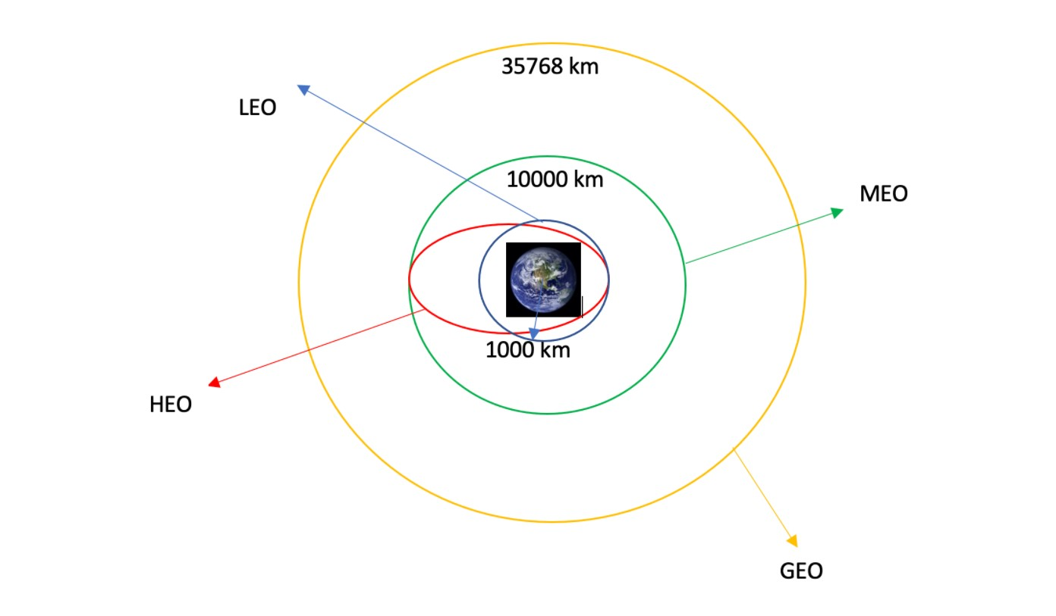
Data Wrangling
Exploratory data analysis (EDA) was performed, and we calculated the number of launches at each site, and the number and occurrence of each orbits
Then we created landing outcome label from outcome column and exported the results to csv.
This is the link to the notebook: https://github.com/marciamk8/testrepo/blob/main/SpaceX%20Data%20Wrangling%20Part%203.ipynb

Slide 14
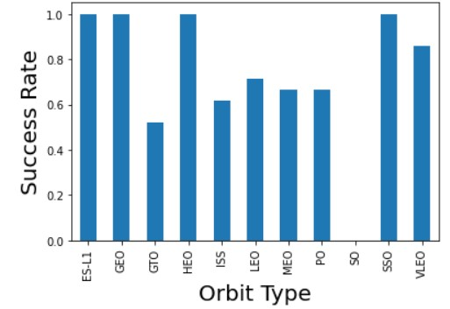
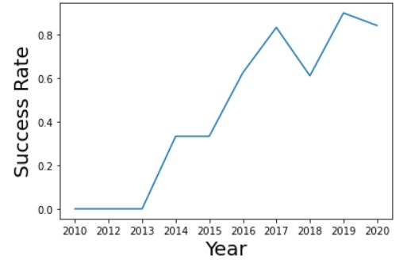
EDA with Data Visualization
The following visualizations show the relationship between success rate of each orbit type with the bar chart so we can find which orbits have high success rate. Also, we can see the visualization of the launch success yearly trend. And we can observe that the success rate since 2013 kept increasing until 2020.
This is the link to the notebook: https://github.com/marciamk8/testrepo/blob/main/SpaceX%20EDA%20Data%20Visualization%20Part%205.ipynb

Slide 15
EDA with SQL
We used MySQL database to process the SpaceX dataset. Doing so, we were able to write queries to find specific information from the data such as:
The names of the unique launch sites in the space mission.
5 records where launch sites begin with the string 'CCA’.
The total payload mass carried by boosters launched by NASA (CRS)
Average payload mass carried by booster version F9 v1.1
The date when the first successful landing outcome in ground pad was achieved.
The total number of successful and failure mission outcomes
This is the link to the notebook: https://github.com/marciamk8/testrepo/blob/main/SpaceX%20EDA%20with%20SQL%20Part%204.docx

Slide 16
Build an Interactive Map with Folium
The map has objects such as markers, circles, lines, etc. to show the success or failure of launches for each site on the folium map.
The classes were assigned 0 and 1 where 0 is for failure, and 1 is for success.
Using the color-labeled marker clusters, we identified which launch sites have relatively high success rate and the distances between a launch site to its proximities was calculated.
This is the link to the notebook: https://github.com/marciamk8/testrepo/blob/main/SpaceX%20Interactive%20Map%20with%20Folium%20Part%206.ipynb

Slide 17
Build a Dashboard with Plotly Dash
A dashboard with Plotly dash was built and it has pie charts showing the total launches by a certain sites
Also, a scatter plot was made, and it shows the relationship with Outcome and Payload Mass (Kg) for the different booster version.
This is the link to the notebook: https://github.com/marciamk8/testrepo/blob/main/SpaceX%20Dashboard%20with%20Plotly%20Dash%20Part%207

Slide 18
Predictive Analysis (Classification)
Using packages such as numpy, pandas, sklearn, etc., the data was loaded transformed and split into training and testing data.
Hyperparameters were created using GridSearchCV and different machine learning models were also built.
How we measured the model was through accuracy and the best classification model was found.
This is the link to the notebook: https://github.com/marciamk8/testrepo/blob/main/SpaceX_Machine%20Learning%20Prediction_Part7.ipynb

Slide 19
Results
Exploratory data analysis results
Interactive analytics demo in screenshots
Predictive analysis results

Slide 20

Section 2

Slide 21
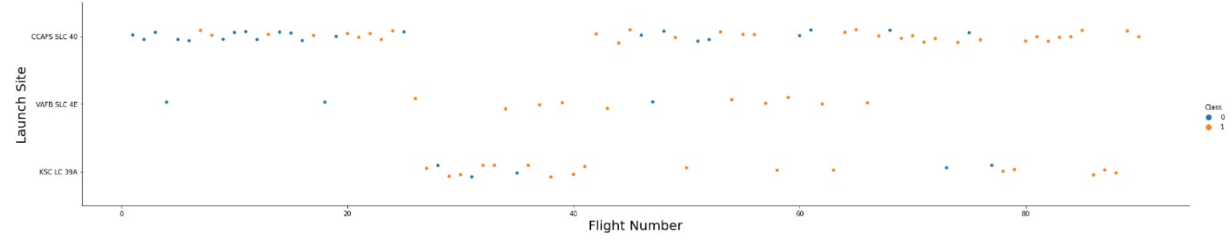
Flight Number vs. Launch Site
The scatter plot bellow demonstrates that the fight number affects the launch site since the larger the flight amount at a launch site the greater the success rate at a launch site.

Slide 22
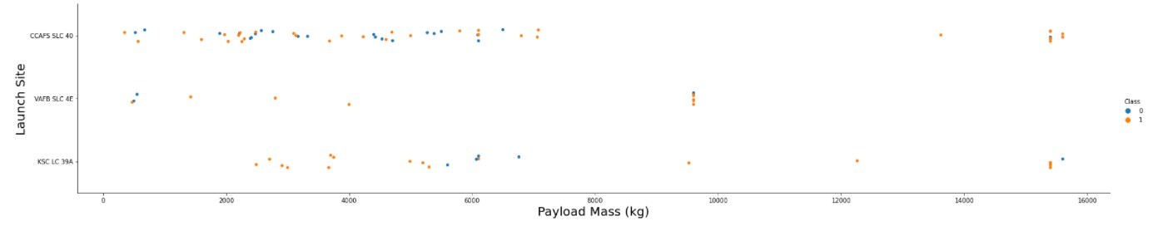
Payload vs. Launch Site
For the scatter plot for Payload vs. Launch Site, Now if you observe Payload Vs. Launch Site, we can see that the VAFB-SLC launch site there are no rockets launched for heavy payload mass (greater than 10000). Also, the greater the Payload is for CCAFS SLC 40 is the greater the success rate is.

Slide 23
Success Rate vs. Orbit Type
As previously shown, the bar chart for the success rate of each orbit type demonstrates that the Orbits with greatest success are ES-L1, GEO, HEO and SSO.

Slide 24
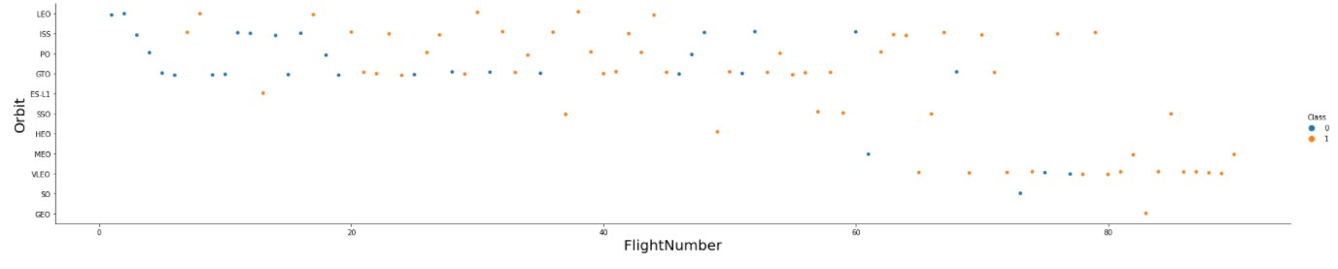
Flight Number vs. Orbit Type
The scatter point of Flight number vs. Orbit type shows that the LEO orbit success is related to the number of flights whereas in the GTO orbit, there is no relationship between flight number and the orbit.

Slide 25
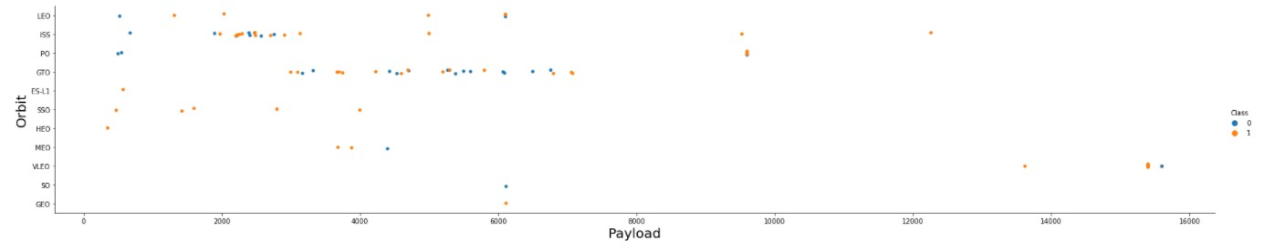
Payload vs. Orbit Type
PO, LEO and ISS orbits have a better successful landing when it comes to the heavy payload according to the scatter plot above.

Slide 26
Launch Success Yearly Trend
The line chart of yearly average success rate shows that since 2013 the success rate has been increasing

Slide 27
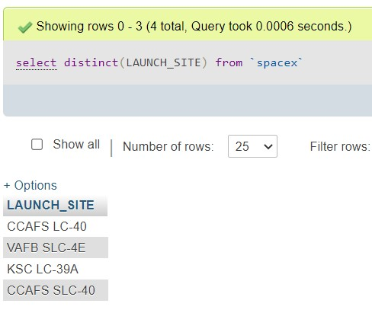
All Launch Site Names
To find the unique Launch site names, we used a query with DISTINCT command to retrieve the names.

Slide 28
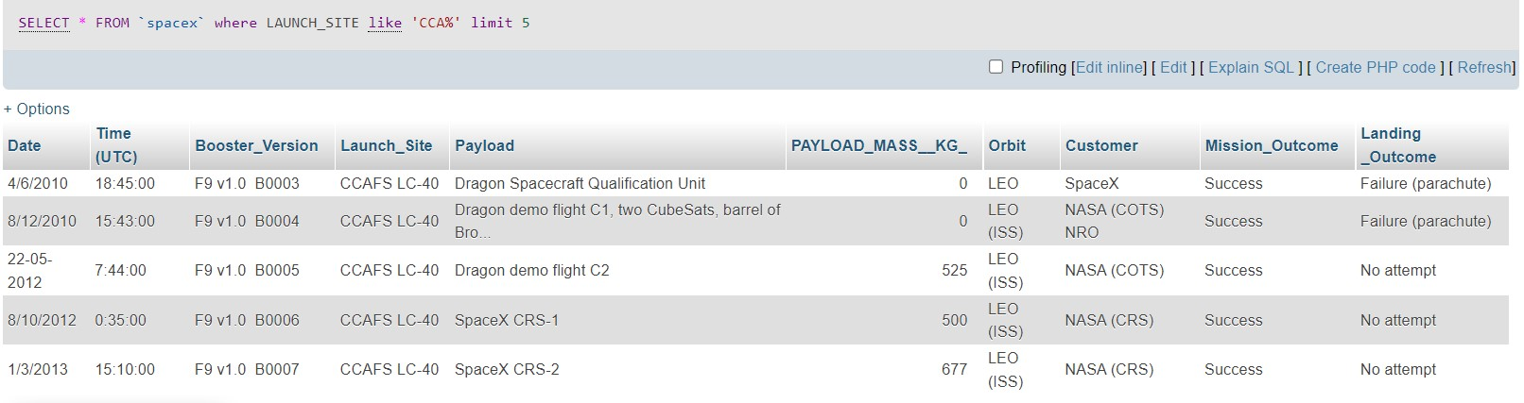
Launch Site Names Begin with 'CCA'
To find the 5 records where launch sites begin with `CCA`, the following query was used

Slide 29
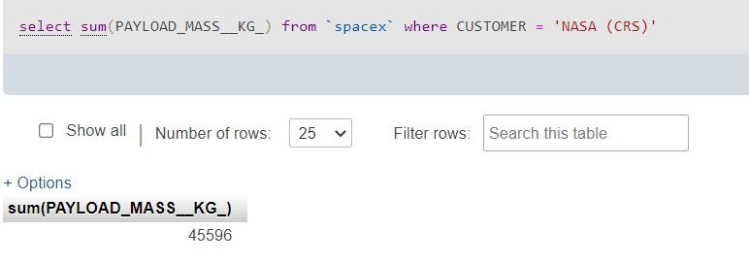
Total Payload Mass
To calculate the total payload carried by boosters from NASA the following query was used to retrieve the results.

Slide 30
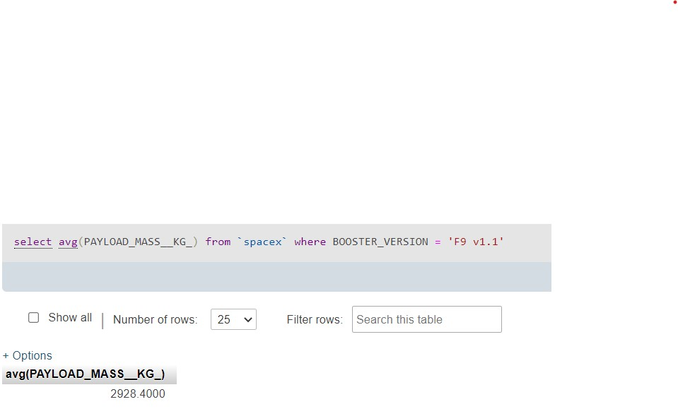
Average Payload Mass by F9 v1.1
To calculate the average payload mass carried by booster version F9 v1.1, we used the average query to find the result

Slide 31
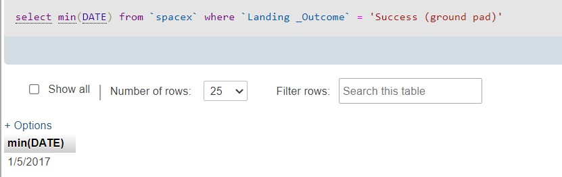
First Successful Ground Landing Date
To find the dates of the first successful landing outcome on ground pad we used minimum for the date and set the Landing Outcome to successful ground landing.

Slide 32
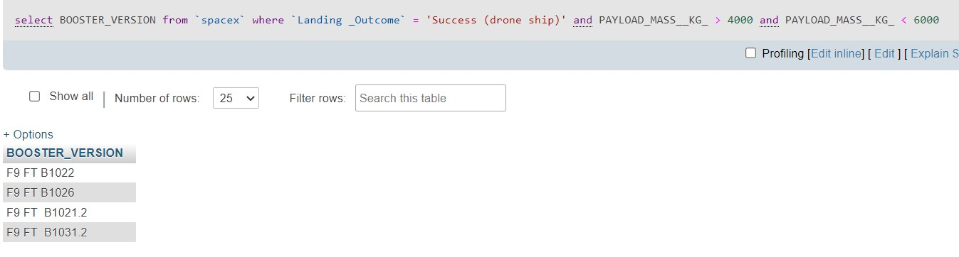
Successful Drone Ship Landing with Payload between 4000 and 6000
Next was to list the names of boosters which have successfully landed on drone ship and had payload mass greater than 4000 but less than 6000 whish the following query found the result.

Slide 33
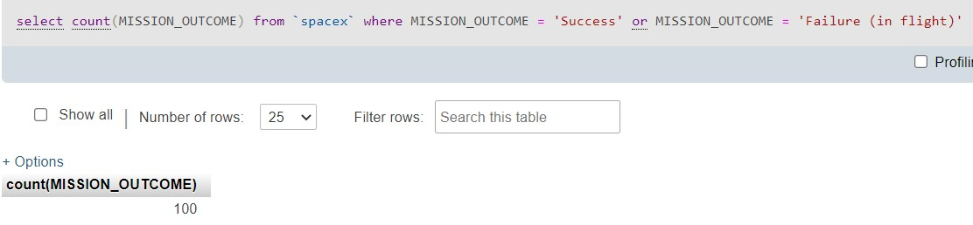
Total Number of Successful and Failure Mission Outcomes
To calculate the total number of successful and failure mission outcomes, we only had to count the mission outcomes where the outcome equal to success or failure.

Slide 34
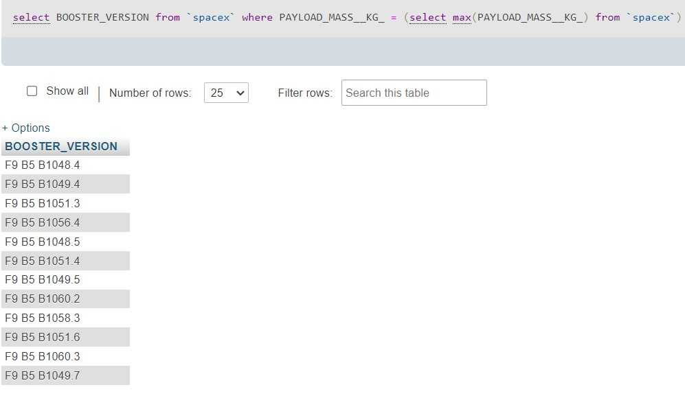
Boosters Carried Maximum Payload
Now, to list the names of the booster which have carried the maximum payload mass, the following query was used.

Slide 35

Section 3

Slide 36

The Launch sites in a global map
Here Replace <Folium map screenshot 1> title with an appropriate title
Explore the generated folium map and make a proper screenshot to include all launch sites’ location markers on a global map
Explain the important elements and findings on the screenshot

Slide 37

The Launch Sites Marked with color labels
Replace <Folium map screenshot 2> title with an appropriate title
Explore the folium map and make a proper screenshot to show the color-labeled launch outcomes on the map
Explain the important elements and findings on the screenshot

Slide 38

The distance the Launch Site to landmarks
Replace <Folium map screenshot 3> title with an appropriate title
Explore the generated folium map and show the screenshot of a selected launch site to its proximities such as railway, highway, coastline, with distance calculated and displayed
Explain the important elements and findings on the screenshot

Slide 39

Section 4

Slide 40
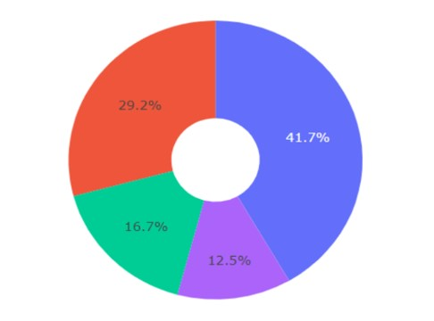
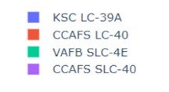
Pie chart showing the success percentage achieved by each launch site
KSC LC-39A had the most successful launch with 41.7% while CCAFS SlC-40 had the least with only 12. 5%

Slide 41
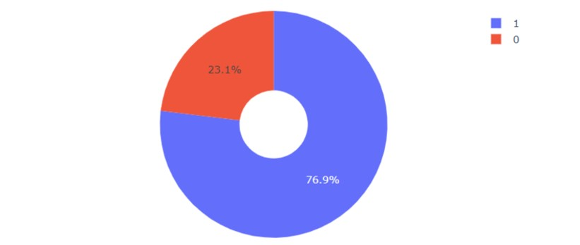
Pie chart showing the Launch site with the highest launch success ratio
KSC LC-39A had the most successful launches with 76.9% of its launches being successful and 23.1% being failure.

Slide 42
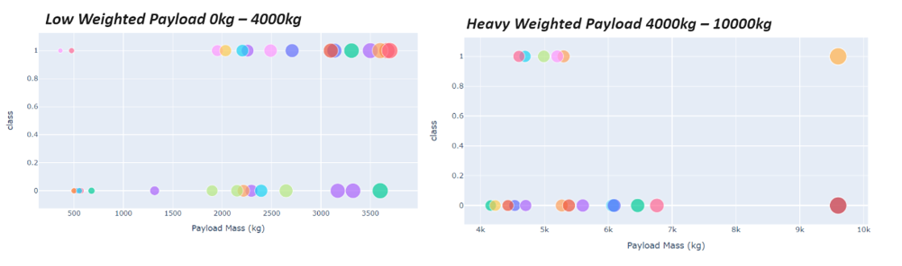
Scatter plot of Payload vs Launch Outcome and different payload selected in the range slider
The e scatter plots show that the lower the payload the higher the success rate is.

Slide 43

Section 5

Slide 44
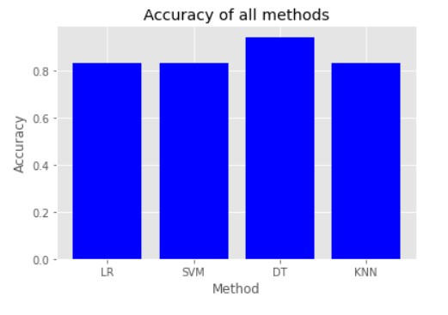
Classification Accuracy
As shown on the built model accuracy for all built classification models, in a bar chart it demonstrates that the Decision Tree method is the best method in this case to have the best accuracy

Slide 45

Confusion Matrix
The confusion matrix for the Decision Tree shows that for the rockets that landed, all of them were labeled correctly. However, for the rockets that did not land 3 were confused that did land so we got 3 False Positives. As such this is the Confusion Matrix for the best performing model.

Slide 46
Conclusions
With this research, we were able to arrive to the following conclusions:
The best results were achieved when the flight amount were the largest at a launch site. That is when we got a greater success rate at a launch site.
The most successful orbits were ES-L1, GEO, HEO and SSO and KSC LC-39A had the most successful launch sites.
The success rate started to increase in 2013 to 2020.
Lastly, the Decision tree is the best machine learning algorithm for this project.

Slide 47


